Slide 1
Surds mini lesson 2

Slide 2
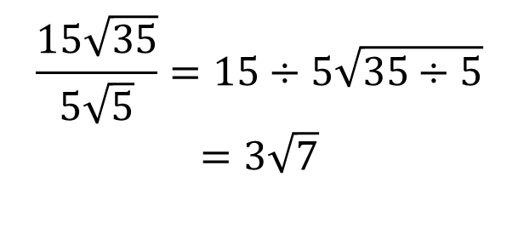

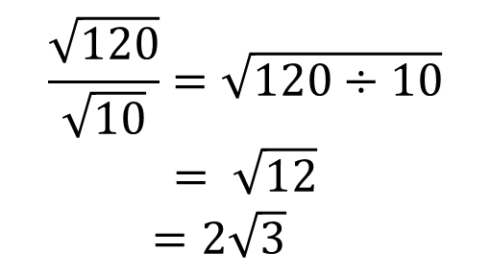
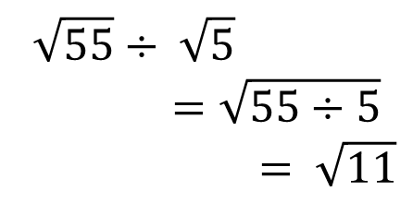
Surds
24
7
30
EQ : What are surds?
Question:
$$\sqrt{55}÷ \sqrt{5}=\sqrt{55÷5}$$
$= \sqrt{11}$
$$\frac{9\sqrt{88}}{6\sqrt{99}}=\frac{9\sqrt{8}}{6\sqrt{9}}$$
$$=\frac{9×2\sqrt{2}}{6×3}$$
$$=\frac{18\sqrt{2}}{18}$$
$= \sqrt{2}$
$$\frac{\sqrt{120}}{\sqrt{10}}=\sqrt{120÷10}$$
$$= \sqrt{12}$$
$=2\sqrt{3}$
$$\frac{15\sqrt{35}}{5\sqrt{5}}=15÷5\sqrt{35÷5}$$
$$=3\sqrt{7}$$

Slide 3
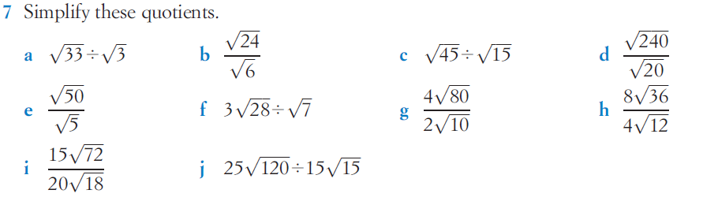

Slide 4

Answers
$$\sqrt{3} \\ \sqrt{10} \\ 1.5$$

Slide 5
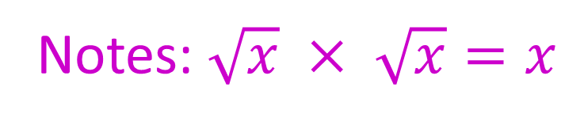
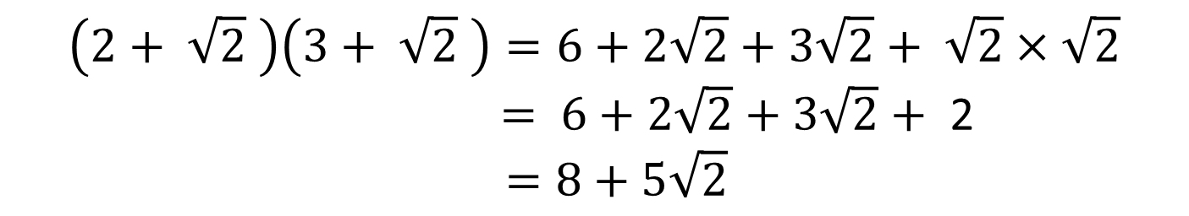
Notes:
Expanding double brackets:
$$\left(2+ \sqrt{2} \right)\left(3+ \sqrt{2} \right)=6+2\sqrt{2}+3\sqrt{2}+ \sqrt{2}×\sqrt{2}$$
$= 6+2\sqrt{2}+3\sqrt{2}+$ 2
$$=8+5\sqrt{2}$$

Slide 6
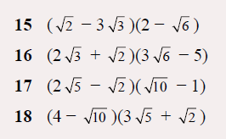

Slide 7




solutions
$$11\sqrt{2}−8√3$$
$$13\sqrt{2}−4\sqrt{3}$$
$$12\sqrt{2}−4√5$$
$$10\sqrt{5}−11√2$$

